Slide 1


Determining
the
Initial Basic Reproduction Number
of
a Virus Infecting a Single Host
John L. Spouge
National Center for Biotechnology Information
NLM, NIH, DHHS
Bldg. 38A, Rm. 6N 603
NCBI, NLM, NIH
Bethesda MD 20894
spouge@nih.gov

Slide 2
Overview
Background
Animal testing is important in developing new therapies against infectious agents (e.g., HIV).
Currently, investigators depend on presence or absence of infection to decide whether a particular therapy reduces infection.
Motivation
In a single host, the basic reproduction number is the average number of cells successfully infected from an infected cell.
If you could estimate the basic reproduction number in early infection of a single host, you could give experimenters another parameter for measuring the efficacy of a possible therapy.
2
T Hatziioannou & DT Evans (2015) PMC4334372

Slide 3
Biological Background

Slide 4
HIV Phylogeny
Primates
Felines
Horses
Small Ruminants
Cattle
The viruses related to HIV provide potential animal models for HIV infection, but have species-specific differences with HIV.
Env
Notes:
JDV, Jembrana Disease acute diarrhea 20% mortality
Jembrana district in Bali, Indonesia
https://en.wikipedia.org/wiki/Jembrana_disease
BIV, Bovine Immunodeficiency Virus
https://en.wikipedia.org/wiki/Bovine_immunodeficiency_virus
CAEV, Caprine Arthritis Encephalitis Virus
https://en.wikipedia.org/wiki/Caprine_arthritis_encephalitis_virus
Arthritis, encephalitis, pneumonia, mastitis
SRLV, Small Ruminant Lentivirus (sheep & goats)
MVV, Maedi(dyspnea)-Visna(neurological) Virus in sheep
Hom = order, Felid

Slide 5
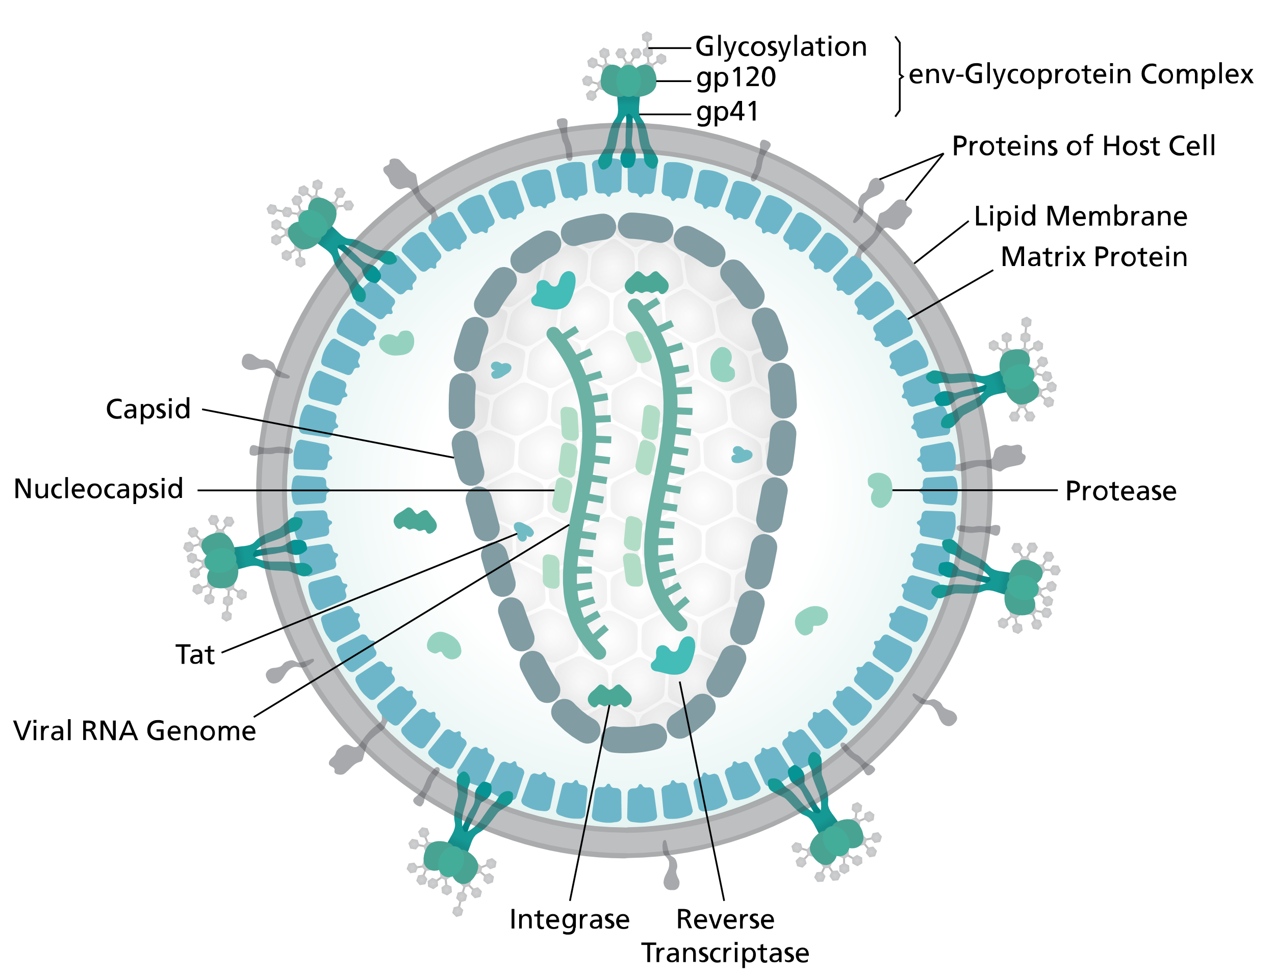
HIV Anatomy
Family Retroviridae
Genus Lentivirus
Species human immunodeficiency virus
120 nm
Lentiviruses are single-stranded, positive-sense, enveloped RNA viruses
by Thomas Splettstoesser (www.scistyle.com) - Own work, CC BY-SA 4.0
https://commons.wikimedia.org/w/index.php?curid=38751738

Slide 6
HIV Animal Models
Animal models are important in testing new therapies against infectious agents in humans.
Animal models are often expensive (e.g., chimpanzees).
Small animal models (SCID mice, FIV in cats) do not mimic HIV infection closely because of species differences in, e.g.,
Receptors, e.g.,
CD4 and either
CC-chemokine receptor 5 (CCR5) or
CXC-chemokine receptor 4 (CXCR4)
Restriction enzymes, e.g.,
APOBEC3G or APOBEC3F hypermutation GRD→ARD
SIV in macaques is currently a popular model.
https://www.hiv.lanl.gov/content/sequence/HYPERMUT/Readme.html
R=(A|G)
D=(A|G|T)
6
T Hatziioannou & DT Evans (2015) PMC4334372

Slide 7
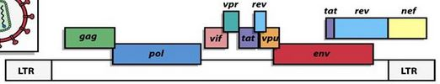
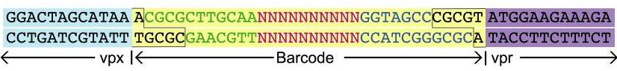
SIV Genes
9.75 kb
The random barcode marks descendants of each virus in a stock.
From a mathematical perspective,
every viral sample came from a single, known founder of infection.
https://slideplayer.com/slide/9725942/31/images/12/HIV+gag+pol+env+genes+are+used+in+our+vaccines.jpg
CM Fennessey (2017) PMC5433785

Slide 8
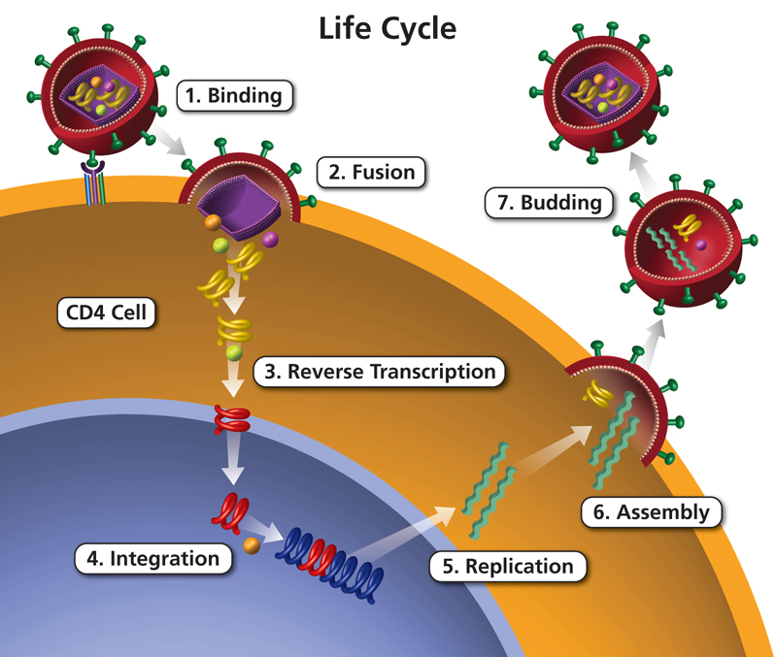
HIV Life Cycle
Binding
gp120
HIV
Fusion
Maturation
Immune Cell
CD4
CCR5/CXCR4
Helper T-cells
Macrophages
Dendritic Cells
Budding
Reverse Transcription
RNA → DNA
Assembly
Budding
is often lytic,
with 10³-10⁴ virions.
Integration
Replication
DNA → RNA
https://aidsinfo.nih.gov/understanding-hiv-aids/glossary/1596/life-cycle
https://aidsinfo.nih.gov/understanding-hiv-aids/fact-sheets/19/73/the-hiv-life-cycle

Slide 9
A Gold Standard Model for HIV Reproduction

Slide 10
Gamma Model for HIV Reproduction
in a single host
Single
0
Founder
1
Poisson distribution
1
mean = r
Basic Reproduction Number
1
in blood
MA Stafford et al. (2000) J Theor Biol 203:285
RM Ribiero et al. (2010) PMC2876646

Slide 11
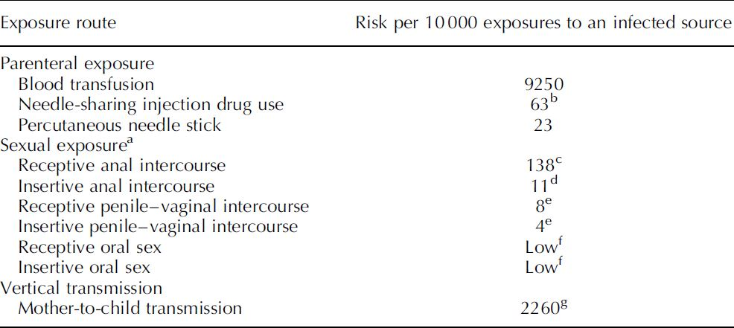
Gamma Model for HIV Reproduction
0
Founder
1
Poisson distribution
1
mean = r
Basic Reproduction Number
1
Table 1
in blood
MA Stafford et al. (2000) J Theor Biol 203:285
RM Ribiero et al. (2010) PMC2876646
P Patel et al. (2014) PMC6195215

Slide 12
The Motivation for the Investigation
Animal models are important in testing new therapies against infectious agents in humans.
Animal models are often expensive (e.g., chimpanzees).
Small animal models (SCID mice, FIV in cats) do not mimic HIV infection closely because of species differences in, e.g.,
Receptors, e.g.,
CD4 and either
CC-chemokine receptor 5 (CCR5) or
CXC-chemokine receptor 4 (CXCR4)
Restriction enzymes, e.g.,
APOBEC3G or APOBEC3F hypermutation GRD→ARD
SIV in macaques is currently a popular model.
12

Slide 13


Slide 14
Gamma Model for HIV Reproduction
PMC2975664
0
“Burst Day”
1
1
1
Time since Infection
EE Giorgi et al. (2010) PMC2975664

Slide 15
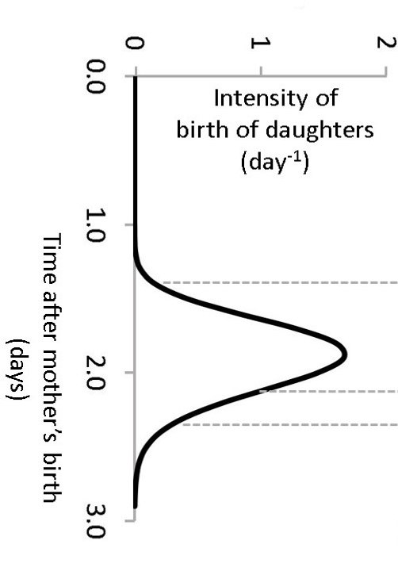
Gamma Model for HIV Reproduction
PMC2975664
0
1
1
1
Gamma distribution
mean = 2 days
st dev = 0.24 days
typical = 2 days
minimum = 1.76 days

Slide 16
Gamma Model for HIV Reproduction
PMC2975664
0
1
1
1

Slide 17
Gamma Model for HIV Reproduction
PMC2975664
Age-dependent Branching Process
0
1
Poisson distribution
1
mean = r
Basic Reproduction Number
1
2
Gamma distribution
mean = 2 days
st dev = 0.24 days
2
2
R Bellman & TE Harris (1952) PMC1079176

Slide 18
Approximations Convenient to Mathematical Solution
uncontrolled approximation

Slide 19
Gamma Model for HIV Reproduction
PMC2975664
Age-dependent Branching Process
0
1
Poisson distribution
1
mean = r
Basic Reproduction Number
1
2
Gamma distribution
mean = 2 days
st dev = 0.24 days
2
2
R Bellman & TE Harris (1952) PMC1079176

Slide 20
PMC2975664
Delta Model
uncontrolled approximation
0
1
Poisson distribution
1
mean = r
Basic Reproduction Number
1
2
Gamma distribution
mean = 2 days
st dev = 0.24 days
Delta distribution
mean = 2 days
st dev = 0 days
2
2

Slide 21
Delta Model
PMC2975664
Galton-Watson Branching Process
0
0
1
Poisson distribution
1
1
1
1
mean = r
Basic Reproduction Number
1
2
2
2
2
2
2
F Galton (1873) Problem 4001. Educational Times 1 April, 17

Slide 22
Model for Reproduction
PMC2975664
0
0
1
1
1
1
1
1
2
2
2
2
2
2

Slide 23


Model for Reproduction
PMC2975664
0
1
1
1
2
2
2
Life is three processes.
reproduction
mutation
selection
Francis Crick “Life Itself”

Slide 24
Model for HIV Mutation

Slide 25
Model for Mutation
PMC2975664
0
1
1
1
2
2
2

Slide 26
Model for Mutation
PMC2975664
site
multiple alignment
column
…acguacguac---c…
0
…acgu---uac---u…
…acguacguac---c…
1
1
1
…acguacguauguac…
…acgu---uac---c…
2
2
2
…acguacguauguau…
…acguacguauguau…

Slide 27
Model for Mutation
PMC2975664
point mutation
…acguacguac---c…
0
…acgu---uac---u…
…acguacguac---c…
1
1
1
…acguacguauguac…
…acgu---uac---c…
2
2
2
…acguacguauguau…
…acguacguauguau…

Slide 28
Model for Mutation
PMC2975664
deletion
…acguacguac---c…
0
…acgu---uac---u…
…acguacguac---c…
1
1
1
…acguacguauguac…
…acgu---uac---c…
2
2
2
…acguacguauguau…
…acguacguauguau…

Slide 29
Model for Mutation
PMC2975664
insertion
…acguacguac---c…
0
…acgu---uac---u…
…acguacguac---c…
1
1
1
…acguacguauguac…
…acgu---uac---c…
2
2
2
…acguacguauguau…
…acguacguauguau…

Slide 30
Model for Mutation
PMC2975664
Each column contains at most one mutation away from the founder,
and each mutation arises in a single ancestor.
…acguacguac---c…
0
…acgu---uac---u…
…acguacguac---c…
1
1
1
…acguacguauguac…
…acgu---uac---c…
2
2
2
…acguacguauguau…
…acguacguauguau…

Slide 31
Infinite-Sites Mutation Model
PMC2975664
0
HIV gp120 has 2550 nt.
HIV mutation rate
2.16x10⁻⁵ mutations / nt / replication
1
1
1
Given the appropriate parameters,
the Galton-Watson process specifies reproduction; the infinite-sites mutation model, mutation.
2
2
2
Poisson distribution
μ = 0.0551 mutations/replication
M Kimura (1969) PMC 1212250

Slide 32
Model for HIV Sampling

Slide 33
Model for Sampling
PMC2975664
0
1
1
1
2
2
2
After the viral population has reached blood, sample M viruses.

Slide 34
Mutations Contain Information about the Viral Basic Reproduction Number

Slide 35
Mutations Contain Information about the Viral Basic Reproduction Number
PMC2975664
In an infinite-sites model, if the founder is the most recent common ancestor of all sample pairs (a star phylogeny), each mutation appears in at most one sample.
0
1
1
1
1
1
1

Slide 36
Mutations Contain Information about the Viral Reproduction Number
PMC2975664
If the viral basic reproduction number is small (i.e., only a little more than 1.0), most mutations appear in more than one sample.
0
0
1
1
1
1
1
1
1
1

Slide 37
Sequence Data Analysis

Slide 38
Sequence Data Analysis
PMC2975664
multiple alignment
…acguacguac---c…
…acgu---uac---u…
Under the infinite-sites model, each column is composed of at most two letters, one from the founder and one from a single mutant ancestor.
…acguacguac---c…
…acguacguauguac…
…acgu---uac---c…
…acguacguauguau…
…acguacguauguau…

Slide 39
Sequence Data Analysis
PMC2975664
…acguacguac---c…
…acgu---uac---u…
…acguacguac---c…
…acguacguauguac…
…acgu---uac---c…
…acguacguauguau…
…acguacguauguau…

Slide 40
Sequence Data Analysis
PMC2975664
Consider only columns with point mutations.
…acguacguac---c…
acguacguacacgc
…acgu---uac---u…
agguacguacacgu
Mutations relative to the founder contain information about the phylogeny of the viral population, but (we assume that) we only have the sampled sequences.
…acguacguac---c…
ucguacguacacgc
…acguacguauguac…
aggugcguguguac
…acgu---uac---c…
accuacguacacgc
…acguacguauguau…
ucgagtaaauguau
…acguacguauguau…
acguacguguguau

Slide 41
Sequence Data Analysis
PMC2975664
11 111
acguacguacacgc
Count the minority letter in each column.
agguacguacacgu
ucguacguacacgc
aggugcguguguac
accuacguacacgc
ucgagtaaauguau
acguacguguguau

Slide 42
Sequence Data Analysis
PMC2975664
221121112
acguacguacacgc
Count the minority letter in each column.
agguacguacacgu
ucguacguacacgc
aggugcguguguac
accuacguacacgc
ucgagtaaauguau
acguacguguguau

Slide 43
Sequence Data Analysis
PMC2975664
22112111233333
acguacguacacgc
Count the minority letter in each column.
agguacguacacgu
ucguacguacacgc
aggugcguguguac
accuacguacacgc
ucgagtaaauguau
acguacguguguau

Slide 44
Sequence Data Analysis
PMC2975664
11 11
22112111233333
acguacguacacgc
Count the minority letter in each column.
agguacguacacgu
ucguacguacacgc
Count the columns
with a given
number of minority letters.
aggugcguguguac
accuacguacacgc
ucgagtaaauguau
acguacguguguau

Slide 45
Sequence Data Analysis
PMC2975664
folded site-frequency
spectrum
22112111233333
acguacguacacgc
Count the minority letter in each column.
agguacguacacgu
ucguacguacacgc
aggugcguguguac
accuacguacacgc
ucgagtaaauguau
acguacguguguau

Slide 46
Statistical Model

Slide 47
The Basic Approximation
The folded site-frequency spectrum (SFS)
contains all available sequence information.
Often, only a few founder viruses (often, just one) initiate a viral infection.
Diffusion approximations (e.g., coalescent theory) are inadequate.
Viral population growth can be explosive.
Continuous-time Markov approximations (e.g., birth-and-death processes) are inadequate.
The folded site-frequency spectrum is directly observable.
47

Slide 48
Statistical Model
PMC2975664
folded site-frequency
spectrum
site-frequency
spectrum
Count the minority letter in each column.
Count the mutated letters in each column.
Count the columns
with a given
number of minority letters.
Count the columns
with a given
number of mutated letters.
Mutations relative to the founder contain information about the phylogeny of the viral population.

Slide 49
Statistical Model
PMC2975664
0
ancestral sample-frequency spectrum
site-frequency
spectrum
1
1
1
Count samples descended
from each ancestor.
Count the mutated letters in each column.
Count mutable ancestors with a given number of sampled descendants.
Count the columns
with a given
number of mutated letters.
2
2
2
Each mutation in each ancestor with m sampled descendants adds a single mutated column,
i.e., it adds 1 to η_{m}.

Slide 50
Statistical Model
PMC2975664
0
ancestral sample-frequency spectrum
site-frequency
spectrum
1
1
1
Count samples descended
from each ancestor.
Count the mutated letters in each column.
2
2
2
Poisson distribution

Slide 51
Statistical Model
PMC2975664
0
ancestral sample-frequency spectrum
site-frequency
spectrum
1
1
1
Count samples descended
from each ancestor.
Count the mutated letters in each column.
2
2
2

Slide 52
Statistical Model
PMC2975664
0
ancestral sample-frequency spectrum
site-frequency
spectrum
1
1
1
Count samples descended
from each ancestor.
Count the mutated letters in each column.
2
2
2

Slide 53
Statistical Model
PMC2975664
0
ancestral sample-frequency spectrum
site-frequency
spectrum
1
1
1
Count samples descended
from each ancestor.
Count the mutated letters in each column.
2
2
2
Law of Total Variance

Slide 54
Statistical Model
PMC2975664
0
ancestral sample-frequency spectrum
site-frequency
spectrum
1
1
1
Count samples descended
from each ancestor.
Count the mutated letters in each column.
2
2
2

Slide 55
Statistical Model
PMC2975664
0
ancestral sample-frequency spectrum
site-frequency
spectrum
1
1
1
Count samples descended
from each ancestor.
Count the mutated letters in each column.
2
2
2

Slide 56
Statistical Model
PMC2975664
0
ancestral sample-frequency spectrum
site-frequency
spectrum
1
1
1
Count samples descended
from each ancestor.
Count the mutated letters in each column.
2
2
2

Slide 57
Statistical Model
PMC2975664
0
ancestral sample-frequency spectrum
site-frequency
spectrum
1
1
1
Count samples descended
from each ancestor.
Count the mutated letters in each column.
mutational
phylogenetic
2
2
2

Slide 58
Statistical Model
PMC2975664
0
ancestral sample-frequency spectrum
site-frequency
spectrum
1
1
1
Count samples descended
from each ancestor.
Count the mutated letters in each column.
mutational
2
2
2

Slide 59

Notations

Slide 60
Mathematical Approximations

Slide 61
Delta Approximation
PMC2975664
JM Ver Hoef (2012) The American Statistician 66: 124-127

Slide 62
ASFS Delta Approximation
PMC2975664
0
ancestral sample-frequency spectrum
1
1
1
Count samples descended
from each ancestor.
2
2
2
approximate probability of descent from fixed ancestor in generation g

Slide 63
ASFS Delta Approximation
PMC2975664
0
ancestral sample-frequency spectrum
1
1
1
Count samples descended
from each ancestor.
2
2
2

Slide 64
ASFS Delta Approximation
PMC2975664
0
ancestral sample-frequency spectrum
1
1
1
Count samples descended
from each ancestor.
2
2
2

Slide 65
ASFS Delta Approximation
PMC2975664
0
ancestral sample-frequency spectrum
1
1
1
Count samples descended
from each ancestor.
2
2
2

Slide 66
ASFS Delta Approximation
PMC2975664
0
ancestral sample-frequency spectrum
1
1
1
Count samples descended
from each ancestor.
2
2
2

Slide 67
Integral Approximation
PMC2975664
0
ancestral sample-frequency spectrum
1
1
1
Count samples descended
from each ancestor.
2
2
2

Slide 68
Integral Approximation
PMC2975664
0
ancestral sample-frequency spectrum
1
1
1
Count samples descended
from each ancestor.
2
2
2

Slide 69
Coalescent Approximation
PMC2975664
0
ancestral sample-frequency spectrum
1
1
1
Count samples descended
from each ancestor.
2
2
2

Slide 70
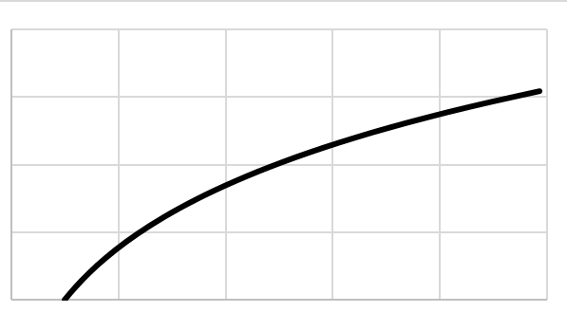
Coalescent vs Integral Approximation
PMC2975664
3.0
2.5
ln r / (1 – 1/r)
2.0
1.5
1.0
0
2
4
6
8
10
Basic reproduction number r

Slide 71
Results Accuracy of SFS Approximations

Slide 72
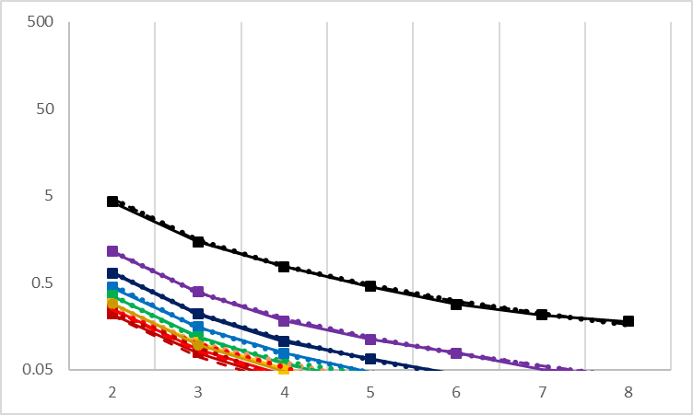
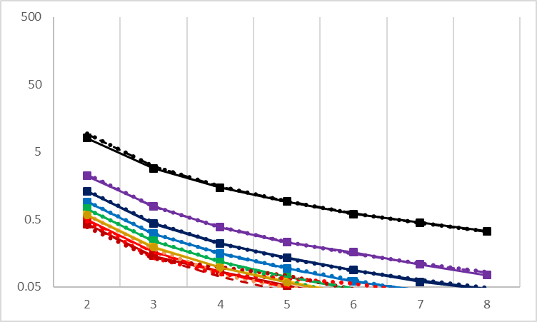
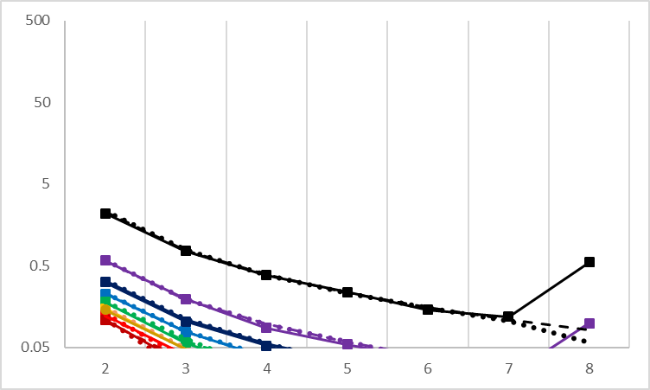
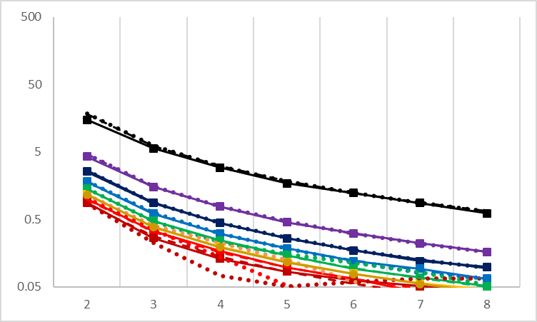
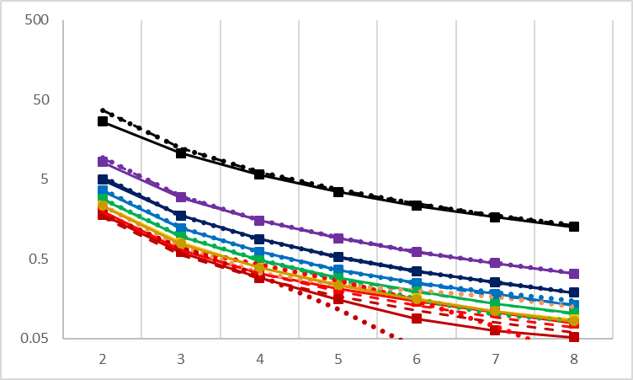
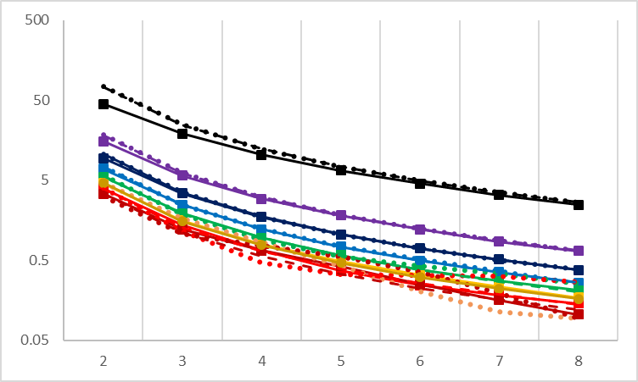
Accuracy of SFS Approximations
M = 8
M = 16
M = 32
50
5
0.5
0.05
Site frequency spectrum η_{m}
M = 128
M = 64
M = 256
50
5
0.5
0.05
2
3
4
5
6
7
8
2
3
4
5
6
7
8
2
3
4
5
6
7
8
Number m of mutations in a column
r = 1.10, 1.46, 1.95, 2.59, 3.45, 4.59, 6.12, 8.14
solid = simulation mean; dot = delta approx; dash = integral approx

Slide 73
Accuracy of SFS Approximations
M = 8
M = 16
M = 32
50
5
0.5
0.05
Site frequency spectrum η_{m}
M = 128
M = 64
M = 256
50
5
0.5
0.05
2
3
4
5
6
7
8
2
3
4
5
6
7
8
2
3
4
5
6
7
8
Number m of mutations in a column
r = 1.10, 1.46, 1.95, 2.59, 3.45, 4.59, 6.12, 8.14
solid = simulation mean; dot = delta approx; dash = integral approx

Slide 74
Accuracy of SFS Approximations
M = 8
M = 16
M = 32
50
5
0.5
0.05
Site frequency spectrum η_{m}
M = 128
M = 64
M = 256
50
5
0.5
0.05
2
3
4
5
6
7
8
2
3
4
5
6
7
8
2
3
4
5
6
7
8
Number m of mutations in a column
r = 1.10, 1.46, 1.95, 2.59, 3.45, 4.59, 6.12, 8.14
solid = simulation mean; dot = delta approx; dash = integral approx

Slide 75
Accuracy of SFS Approximations
M = 8
M = 16
M = 32
50
5
0.5
0.05
Site frequency spectrum η_{m}
M = 128
M = 64
M = 256
50
5
0.5
0.05
2
3
4
5
6
7
8
2
3
4
5
6
7
8
2
3
4
5
6
7
8
Number m of mutations in a column
r = 1.10, 1.46, 1.95, 2.59, 3.45, 4.59, 6.12, 8.14
solid = simulation mean; dot = delta approx; dash = integral approx

Slide 76
Statistical Methods

Slide 77
Poisson Log-likelihood for r
PMC2975664
0
ancestral sample-frequency spectrum
folded site-frequency
spectrum
1
1
1
Count samples descended
from each ancestor.
Count the minority letters in each column.
2
2
2

Slide 78
Delta MLE for r
PMC2975664
0
ancestral sample-frequency spectrum
site-frequency
spectrum
1
1
1
Count samples descended
from each ancestor.
Count the minority letters in each column.
2
2
2

Slide 79
Delta MLE for r
PMC2975664
0
ancestral sample-frequency spectrum
folded site-frequency
spectrum
1
1
1
Count samples descended
from each ancestor.
Count the minority letters in each column.
2
2
2

Slide 80
Euler-Maclaurin MLE for r
PMC2975664
0
ancestral sample-frequency spectrum
site-frequency
spectrum
1
1
1
Count samples descended
from each ancestor.
Count the minority letters in each column.
2
2
2

Slide 81
Method of Moments for r
PMC2975664
0
ancestral sample-frequency spectrum
site-frequency
spectrum
1
1
1
Count samples descended
from each ancestor.
Count the minority letters in each column.
2
2
2

Slide 82
Simulation Results Recovery of r from SFS Data

Slide 83


Slide 84
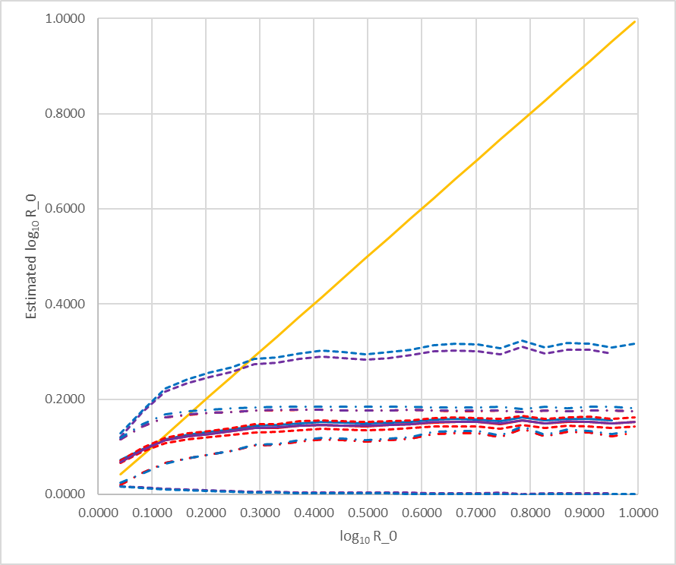
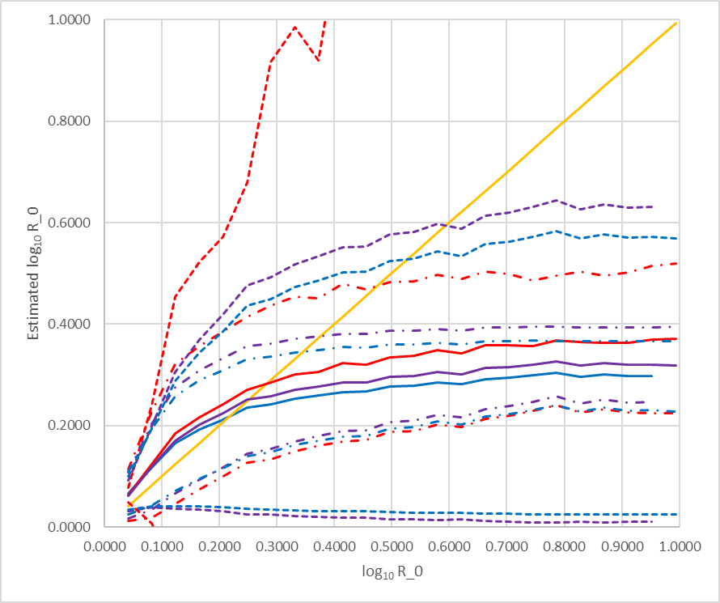
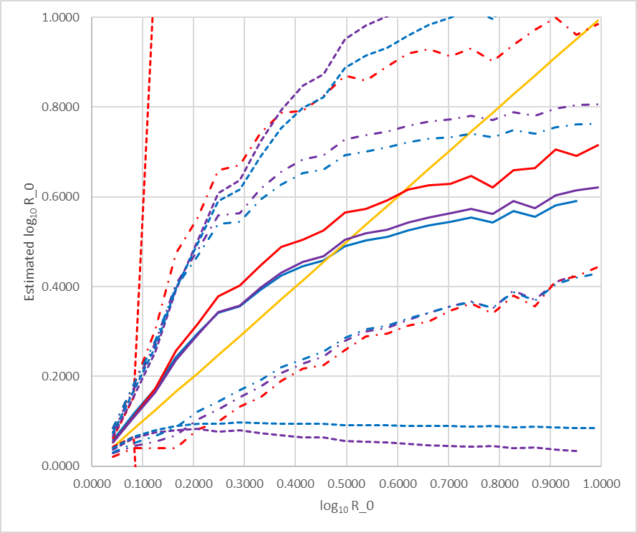
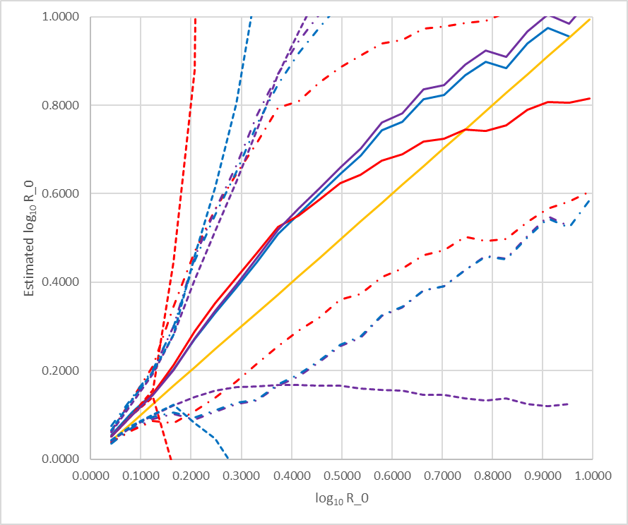
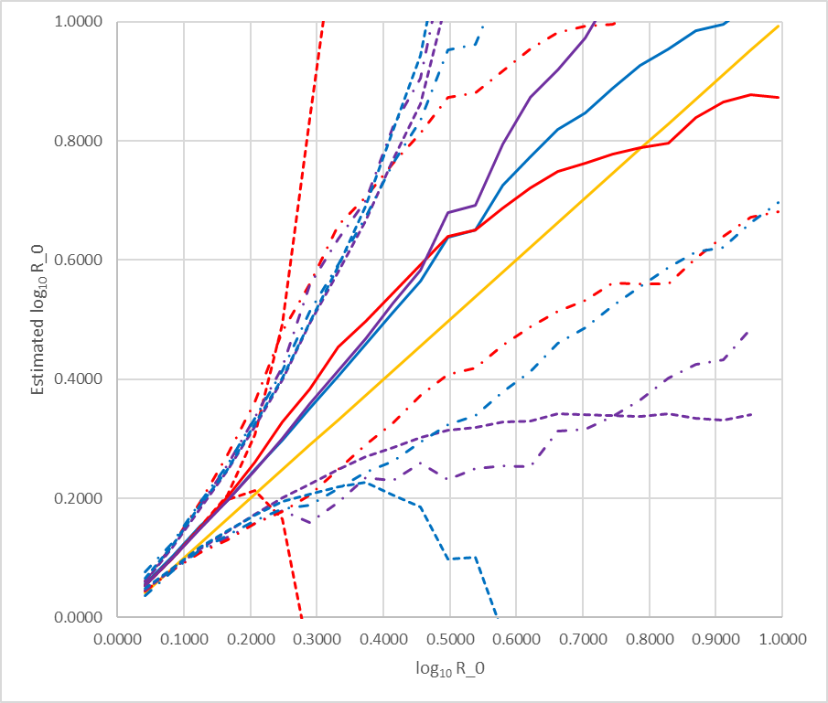
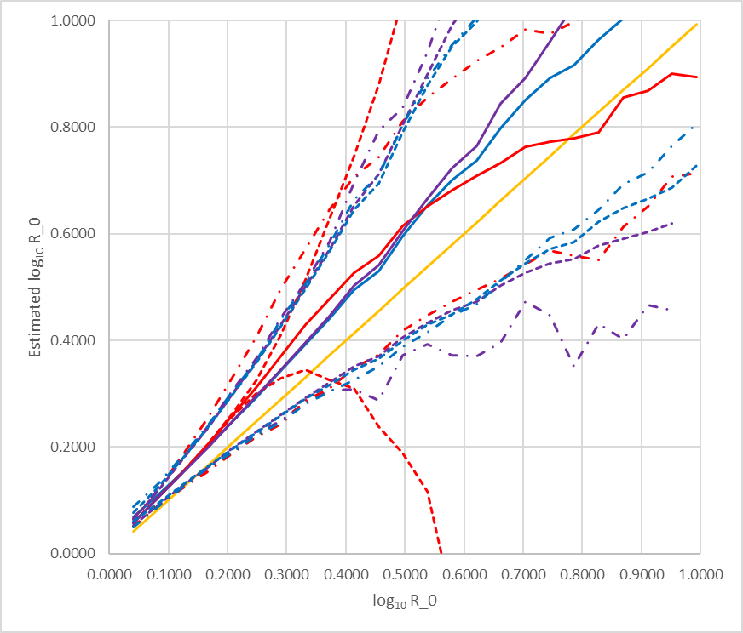
Accuracy of SFS Approximations
1.0
M = 8
M = 16
M = 32
0.5
0.0
Estimated log₁₀ r
1.0
M = 64
M = 128
M = 256
0.5
0.0
0.0
0.5
1.0
0.0
0.5
1.0
0.0
0.5
1.0
True log₁₀ r
solid = sample mean; dash-dot = sample st dev; dash = est. error
red = delta MLE; purple = integral MLE; blue = method of moments

Slide 85
Accuracy of SFS Approximations
1.0
M = 8
M = 16
M = 32
0.5
0.0
Estimated log₁₀ r
1.0
M = 64
M = 128
M = 256
0.5
0.0
0.0
0.5
1.0
0.0
0.5
1.0
0.0
0.5
1.0
True log₁₀ r
solid = sample mean; dash-dot = sample st dev; dash = est. error
red = delta MLE; purple = integral MLE; blue = method of moments

Slide 86
Accuracy of SFS Approximations
1.0
M = 8
M = 16
M = 32
0.5
0.0
Estimated log₁₀ r
1.0
M = 64
M = 128
M = 256
0.5
0.0
0.0
0.5
1.0
0.0
0.5
1.0
0.0
0.5
1.0
True log₁₀ r
solid = sample mean; dash-dot = sample st dev; dash = est. error
red = delta MLE; purple = integral MLE; blue = method of moments

Slide 87
Accuracy of SFS Approximations
1.0
M = 8
M = 16
M = 32
0.5
0.0
Estimated log₁₀ r
1.0
M = 64
M = 128
M = 256
0.5
0.0
0.0
0.5
1.0
0.0
0.5
1.0
0.0
0.5
1.0
True log₁₀ r
solid = sample mean; dash-dot = sample st dev; dash = est. error
red = delta MLE; purple = integral MLE; blue = method of moments

Slide 88


Slide 89


Slide 90
Accuracy of SFS Approximations
1.0
M = 8
M = 16
M = 32
0.5
0.0
Estimated log₁₀ r
1.0
M = 64
M = 128
M = 256
0.5
0.0
0.0
0.5
1.0
0.0
0.5
1.0
0.0
0.5
1.0
True log₁₀ r
solid = sample mean; dash-dot = sample st dev; dash = est. error
red = delta MLE; purple = integral MLE; blue = method of moments

Slide 91


Slide 92
Overview
Background
Animal testing is important in developing new therapies against infectious agents (e.g., HIV).
Currently, investigators depend on presence or absence of infection to decide whether a particular therapy reduces infection.
Motivation
In a single host, the basic reproduction number is the average number of cells successfully infected from an infected cell.
If you could estimate the basic reproduction number in early infection of a single host, you could give experimenters another parameter for measuring the efficacy of a possible therapy.
92
T Hatziioannou & DT Evans (2015) PMC4334372

Slide 93
Collaborators
Vruj Patel, NCBI

Slide 94

94

